Slide 1

IMAGE RECOGNITION OF SPECIES USING CNN
SR University Anathasagar, Hasanparthy, Hanumakonda 506371 DEPARTMENT OF CSE & AI
UNDER THE GUIDANCE OF DR. Ratnesh Ranjan
BATCH NO : 56
ABHINAY – 2103A51527
YASHWANTH – 2103A51439
BHARATH REDDY – 2103A51524
VAMSHI – 2103A51375
DAYAKAR RAO – 2103A51211

Slide 2
CONTENTS
Title Explanation
Abstract
Introduction
Problem Statement
Objectives
Methodology
Implementation.
Results & Discussion
Conclusion & Future Scope .
References

Slide 3
Title explanation
Liver Disease :It refers to medical condition affecting the liver, such as hepatitis, cirrhosis, fatty liver disease, etc. Liver diseases can have various causes and symptoms and can be diagnosed through medical tests and analysis.
Analysis and prediction: It involves analysis and interpretation of data related to liver health, which helps in prediction and forecasting or estimating the likelihood of certain outcomes, such as the development or progression of liver disease based on available data.
KNN (K-Nearest Neighbor): KNN is a supervised machine learning algorithm used for classification and regression tasks. In classification, KNN predicts the class of a data point by looking at the 'k' nearest data points and determining the majority class among them. In regression, it predicts the value of a data point by averaging the values of its 'k' nearest neighbors.

Slide 4
Abstract
Liver diseases are significant health concern globally, attributed to various factors including alcohol consumption, exposure to environmental toxins, and poor dietary habits. Early detection of liver disease is crucial as it allows for timely intervention and management, which can significantly improve patient outcomes and reduce the burden on healthcare systems. The main aim of our project is to detect the liver disease accurately using parameters like age ,gender, total Bilirubin, Alkaline phosphatase, Aspartate aminotransferase, Albumin, Globulin ranges. The Existing model used to predict the liver cancer by using the random forest algorithm. The drawback of existing system is that the accuracy of model is less. The proposed model used to detect liver disease using K-Nearest Neighbor (K-NN) technique. The steps we follow to implement our model include collecting and preprocessing relevant datasets, identifying informative features, and training machine learning algorithms, the system can accurately detect the likelihood of liver cancer development or progression.

Slide 5
Introduction
With a growing trend of sedentary and lack of bodily activities, diseases associated with liver have become a common come upon these days. Viral hepatitis alone reasons 1.34 million deaths every year. An early diagnosis of liver problems will boom affected person’s survival rate.
Liver screw ups are at high fee of danger amongst Indians. It's far expected that by way of 2025 India may emerge as the sector capital for liver sicknesses. The sizeable occurrence of liver contamination in India is contributed due to deskbound life-style, extended alcohol consumption and smoking.
There are approximately a hundred varieties of liver infections. With such alarming figures, it is essential to have a subject in the direction of tackling those sicknesses. Afterall, we cannot assume an advanced and wealthy state, with unhealthy youths.
Symptoms of liver disease include: Pain in the abdomen ,prone to bruising ,indigestion or vomiting, swelling in your legs or arms. Your risk of developing liver cancer can be increased by certain types of liver disease. Others continue to harm your liver if left untreated. Scarring, or cirrhosis, develops. Over the long haul, a harmed liver will not have sufficient sound tissue to work. Failure of the liver can result from untreated liver disease.

Slide 6
Problem Statement
The problem statement of this project revolves around the need to build a model which can accurately identify the liver disease by using certain parameters.
The existing system used the random forest and decision tree algorithm to build a model for liver disease prediction. The models achieved about 60 - 70% accuracy for predicting the liver disease.
The Proposed system uses KNN algorithm to build the model and It aims to achieve the better prediction and accuracy compared to the previous models.

Slide 7
Objectives
Early Detection: To develop a predictive model capable of identifying individuals at risk of developing liver disease at an early stage, enabling timely interventions and preventive measures to mitigate disease progression and complications.
Accuracy and Reliability: To Improve the accuracy and reliability of liver disease prediction model to ensure effective clinical decision-making and patient management.
Patient Empowerment: Empower patients with information about their liver health status, risk factors, and personalized recommendations for lifestyle modifications, preventive screenings, and follow-up care to promote active engagement in disease management and improve long-term health outcomes.

Slide 8
Methodologies
Data Collection: First we have collected the dataset containing patient medical features and corresponding labels indicating the presence or absence of liver disease. The dataset includes the parameters such age ,gender, total Bilirubin, Alkaline phosphatase, Aspartate aminotransferase, Albumin, Globulin ranges.
Data Preprocessing: At this stage, it will perform data cleansing ,The cleansing process is to transform the data which has some missing values or incomplete data into default values by using median value, and Scale numerical features to a similar range to prevent features with larger scales from dominating the distance calculations in KNN. Identify and select the most relevant features for liver disease prediction. This can help reduce dimensionality and improve the model's performance.
Data Splitting: The dataset is divided into two subsets: a training set and a testing set. The training set, is used to train the KNN model and the testing set is used to test the KNN model.

Slide 9
Methodologies
Model architecture: To build a model using KNN for analyzing the liver patients dataset , to predict the accurate liver disease.
Model Training: The model is fed with the preprocessed dataset to learn patterns and relationships between features and their corresponding labels. Initially, the KNN algorithm initializes with a chosen value of k, representing the number of nearest neighbors to consider for classification.
Model Evaluation: During evaluation, the trained model is tested using a separate dataset that it has not encountered during training, commonly referred to as the testing set.

Slide 10
Implementation
C:\Users\shiva\OneDrive\Desktop\project 3-2

Slide 11
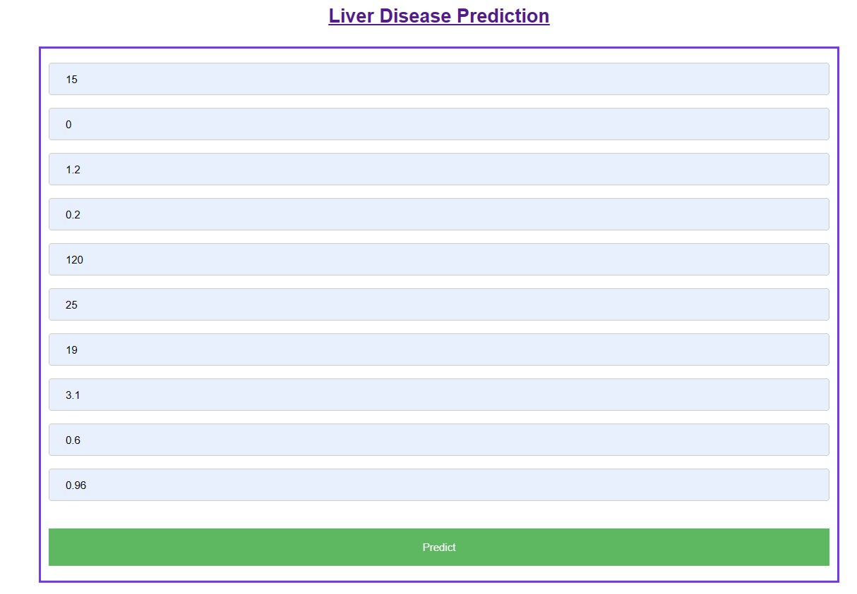
Result & Discussion

Slide 12
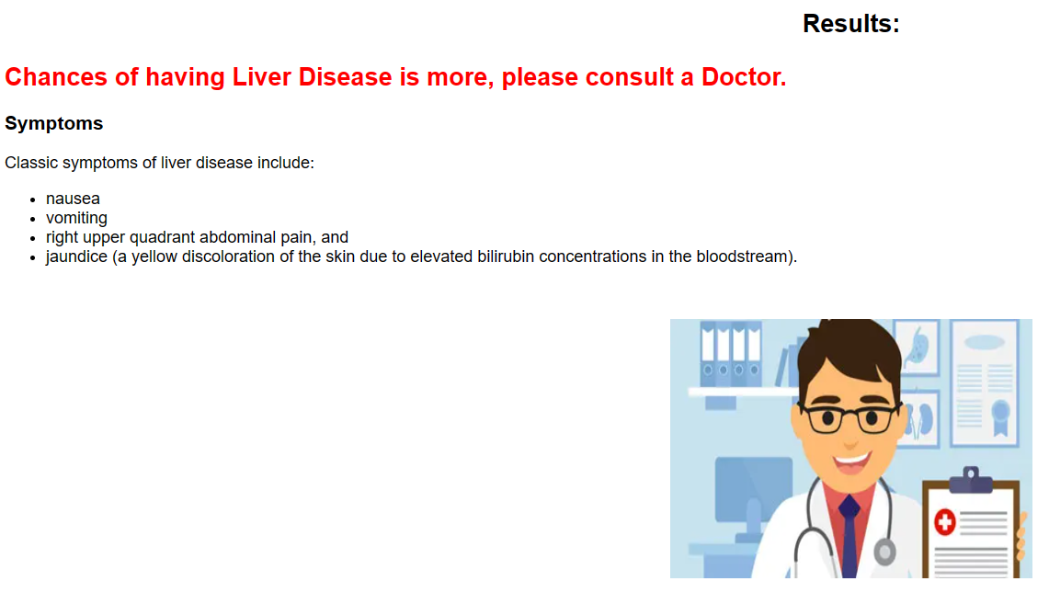

Slide 13
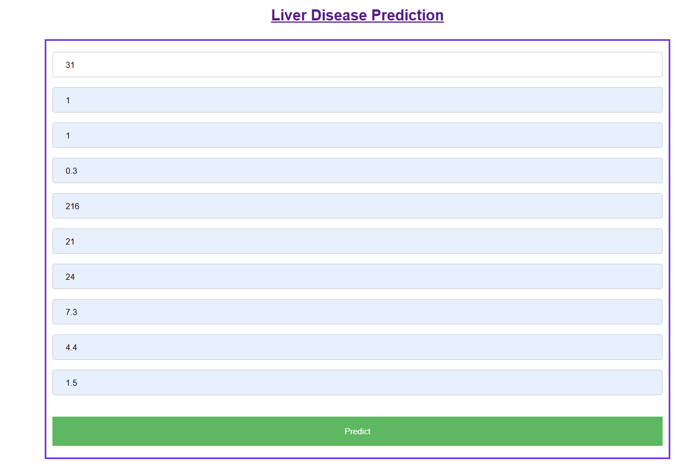

Slide 14
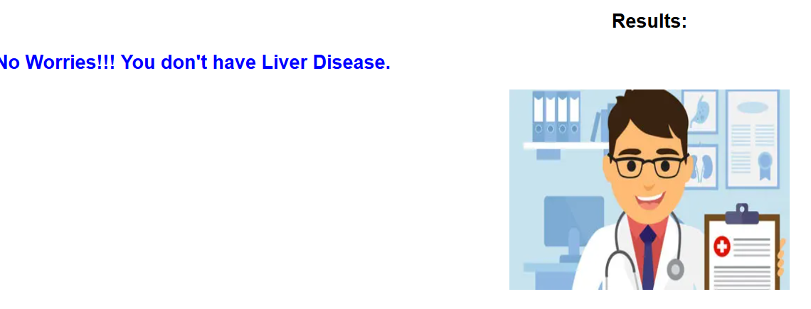

Slide 15
Conclusion & Future Scope
In conclusion, the liver disease analysing and prediction project utilizing the K-Nearest Neighbor (KNN) algorithm offers a promising approach in improving the prediction of outcomes for patients at risk of liver disease. By analyzing patient data and identifying key patterns, KNN enables early detection of chances of having liver disease. Its simplicity, efficiency, and effectiveness make it a valuable tool for healthcare professionals in early detection, diagnosis, and proactive management of liver diseases. In future we would try to enhance the algorithm's performance, particularly in handling large-scale datasets and improving its predictive accuracy. The K-NN model can be continuously improved by incorporating new data and features, enabling more accurate and reliable liver disease prediction. The K-NN technique can be applied to other diseases, enabling the development of accurate and reliable predictive models for various medical conditions.

Slide 16
Reference
Gupta, A., Biwal, R., Joshi, S., & Singh, P. A COMPARATIVE STUDY ON LIVER DISEASE PREDICTION USING SUPPORT VECTOR MACHINE ALGORITHM.
W. Yu, T. Liu, R. Valdez, M. Gwinn, and M. J. Khoury, ‘‘Application of support vector Machine modeling for prediction of common diseases: The case of diabetes and pre-diabetes,’’ BMC Med. Inform. Decis. Making, vol. 10, no. 1, p. 16, 2010.
Q. Zou, K. Qu, Y. Luo, D. Yin, Y. Ju, and H. Tang, ‘‘Predicting diabetes mellitus with machine learning techniques,’’ Frontiers Genet., vol. 9, p. 515, Nov. 2018.
Z.-H. Zhou, Y. Jiang, Y.-B. Yang, and S.-F. Chen, ‘‘Lung cancer cell identification based on artificial neural network ensembles,’’ Artif. Intell. Med., vol. 24, no. 1, pp. 25–36, 2002.
S. F. Dessai, ‘‘Intelligent heart disease prediction system using probabilistic neural network,’’ Int. J. Adv. Comput. Theory Eng., vol. 2, no. 3, pp. 2319–2526, 2013
B. E. Bejnordi et al., ‘‘Diagnostic assessment of deep learning algorithms for detection of lymph node metastases in women with breast cancer,’’ JAMA, vol. 318, no. 22, pp. 2199–2210, Dec. 2017

Slide 17
Y. Cao, Z.-D. Hu, X.-F. Liu, A.-M. Deng, and C.-J. Hu, ‘‘An MLP classifier for prediction of HBV-induced liver cirrhosis using routinely available clinical parameters,’’ Disease Markers, vol. 35, no. 6, pp. 653– 660, 2013.
K. Hornik, M. Stinchcombe, and H. White, ‘‘Multilayer feedforward networks are universal approximators,’’ Neural Netw., vol. 2, no. 5, pp. 359–366, 1989.
G. E. Hinton, S. Osindero, and Y.-W. Teh, ‘‘A fast learning algorithm for deep belief nets,’’ Neural Comput., vol. 18, no. 7, pp. 1527–1554, 2006.
A. L. Samuel, ‘‘Some studies in machine learning using the game of checkers,’’ IBM J. Res. Develop., vol. 3, no. 3, pp. 29–210, 1959.
K. Tretyakov, ‘‘Machine learning techniques in spam filtering,’’ Data Mining Problem-Ori
D. West and V. West, ‘‘Improving diagnostic accuracy using a hierarchical neural network to model decision subtasks,’’ Int. J. Med. Inform., vol. 57, no. 1, pp. 41–55, 2000. ented Seminar, MTAT, vol. 3, no. 177, pp. 60–79, 2004
Divya, B, Kalaiselvi, R, Review on Confidentiality of the Outsourced Data, Research Journal of Science and Engineering Systems, vol.1, pp.1-7, 2017.

Slide 18
D. S. Kermany et al., ‘‘Identifying medical diagnoses and treatable diseases by image-based deep learning,’’ Cell, vol. 172, no. 5, pp. 1122–1131, 2018.
M. Poostchi, K. Silamut, R. J. Maude, S. Jaeger, and G. Thoma, ‘‘Image analysis and machine learning for detecting malaria,’’ Transl. Res., vol. 194, pp. 36–55, Apr. 2018

Slide 19
THANK YOU

